Slide 1
JavaScript Week 6
Log into your computers
Open up Atom and create a folder in HTML specific for JavaScript
If Club site is not presented by Wednesday of next week you will receive a zero for the assignment
FreeCodeBootCamp
Objective
The student should be able to create buttons, and change the function of a website.

Slide 2
JavaScript
Javascript was created by Brendan Eich
Do not confuse it with Java these are two different things entirely
A script or scripting language is a computer language with a series of commands within a file that is capable of being executed without being compiled.

Slide 3
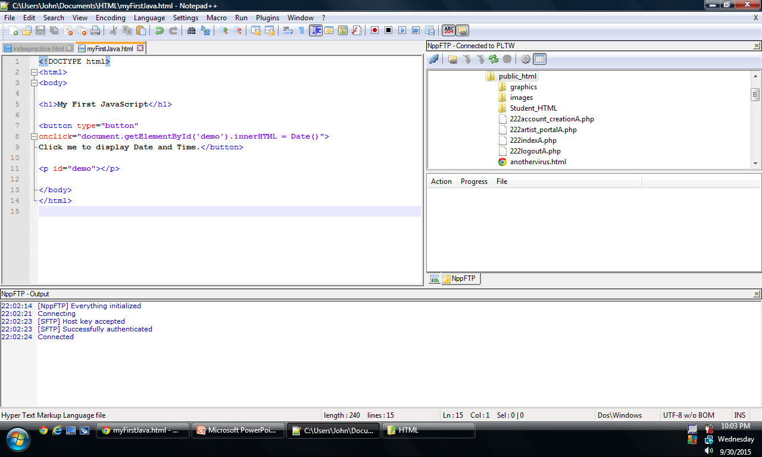
<!DOCTYPE html>
<html>
<body>
<h1>My First JavaScript</h1>
<button type="button"
onclick="document.getElementById('demo').innerHTML = Date()">
Click me to display Date and Time.</button>
<p id="demo"></p>
</body>
</html>

Slide 4
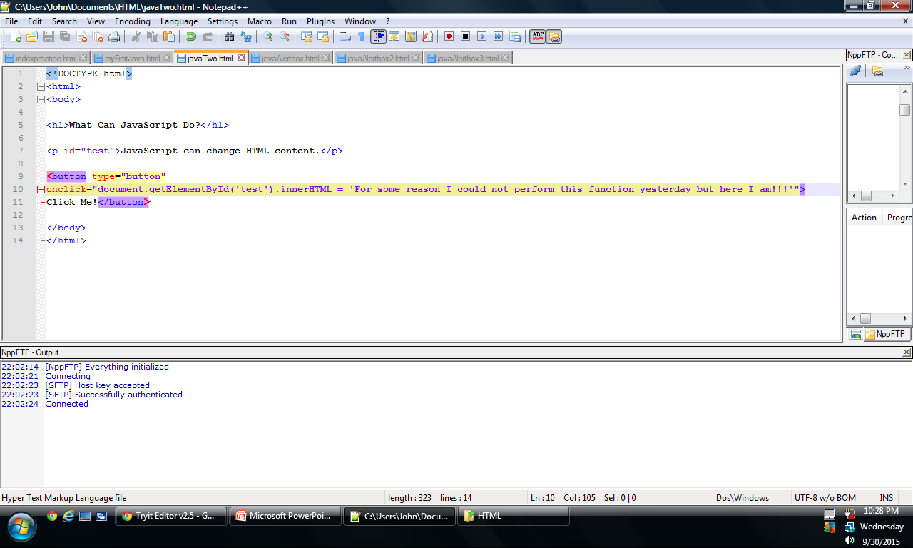

Slide 5
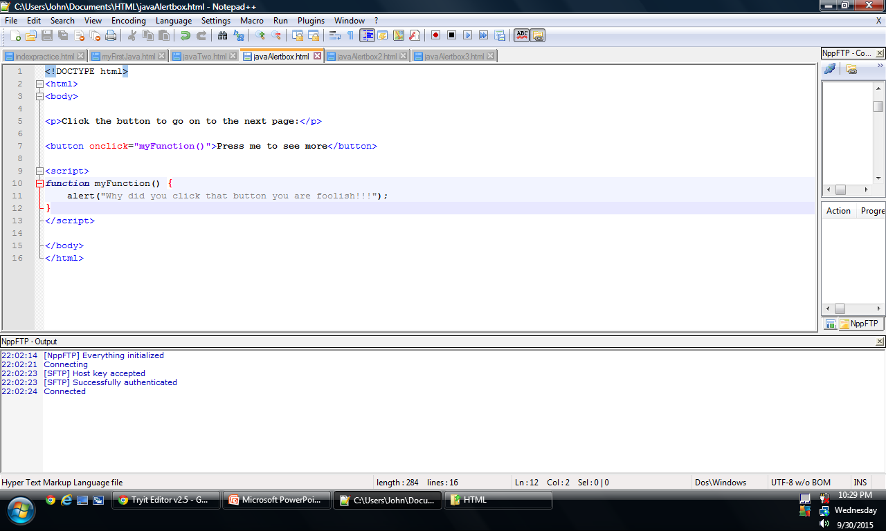

Slide 6
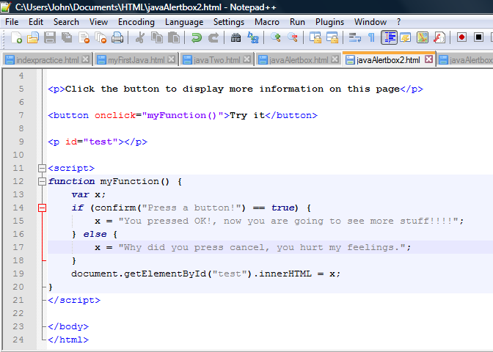

Slide 7
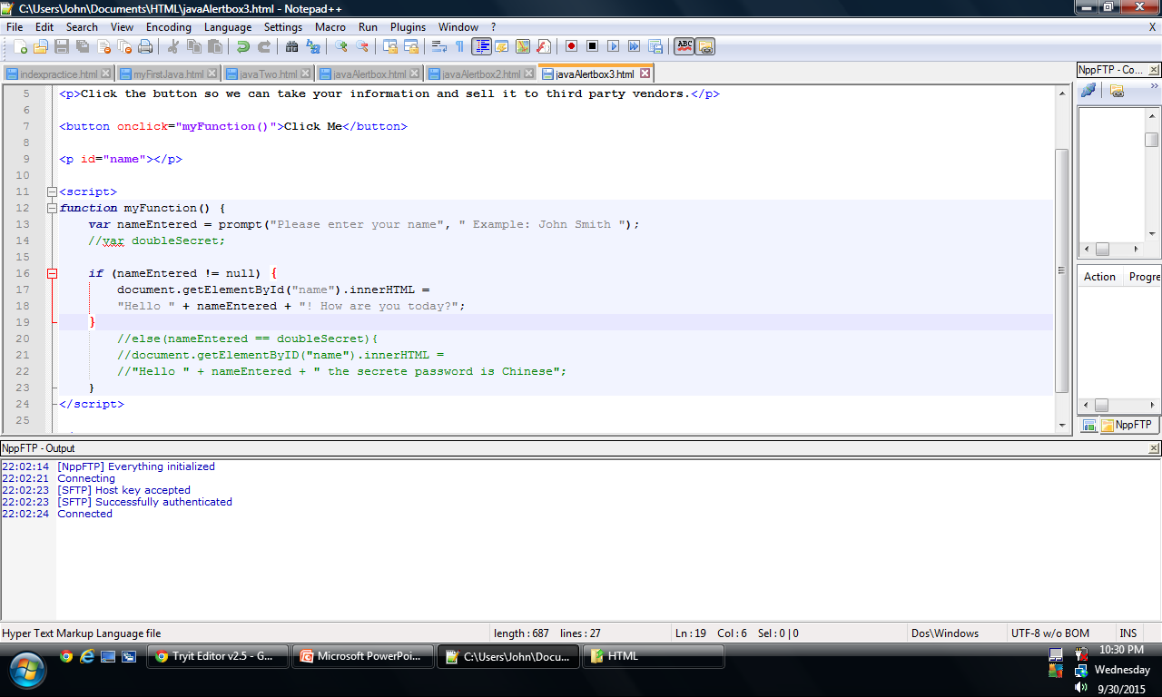

Slide 8
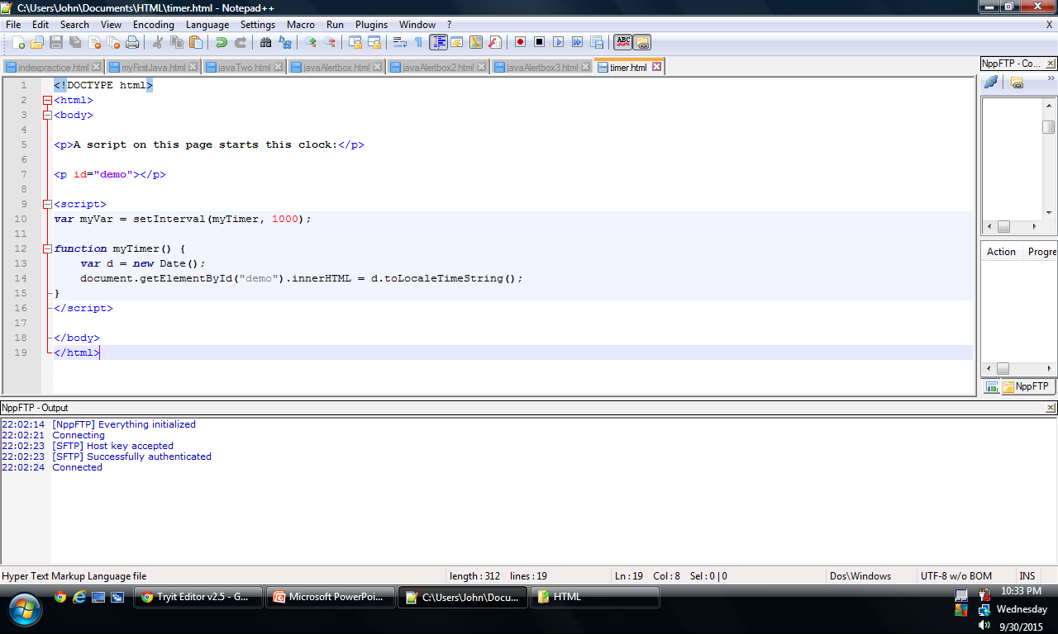

Slide 9
Line Breaks in JavaScript
\n

Slide 10
Learning JavaScript variables
Get out your notebook
Will need a pen or pencil
Objective
Student will learn about variables when it comes to Programming in HTML, and will be able to produce a variable outcome when finished.

Slide 11
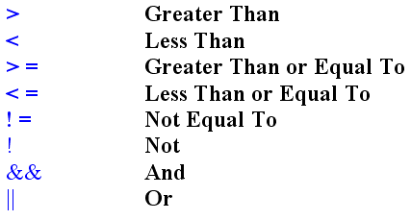
JavaScript statements are composed of:
Values, Operators, Expressions, Keywords, and Comments.
When naming values use CamelCase or Camel_Case
But not camelcase or
Camel-Case
//We Need to get better
//at commenting

Slide 12
JavaScript Values
The JavaScript syntax defines two types of values: Fixed values and variable values.
Fixed values are called literals.
Variable values are called variables.

Slide 13
Strings
Strings are text, written within double or single quotes:
Example in: string.html

Slide 14
Expressions can also contain variable values:
Concatenate-link (things) together in a chain or series. "some words may be concatenated, such that certain sounds are omitted“
Latin concatenate= ‘linked together”
=“Mr.” + “ “ + “Brosius”;

Slide 15
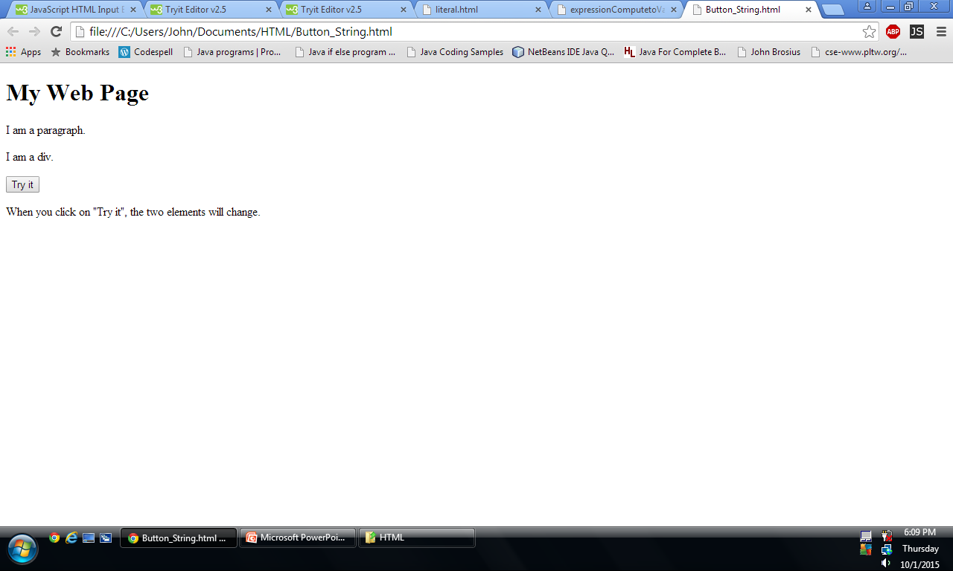
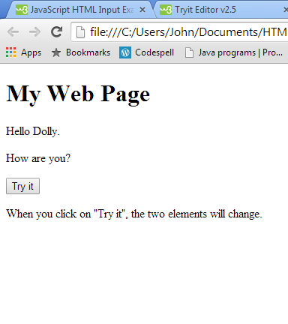
Buttons + String

Slide 16
Loading New Document
This can be used to load a new web page or load a pdf file, excel, xml, song, video, etc.
Example: LoadButtonPage

Slide 17
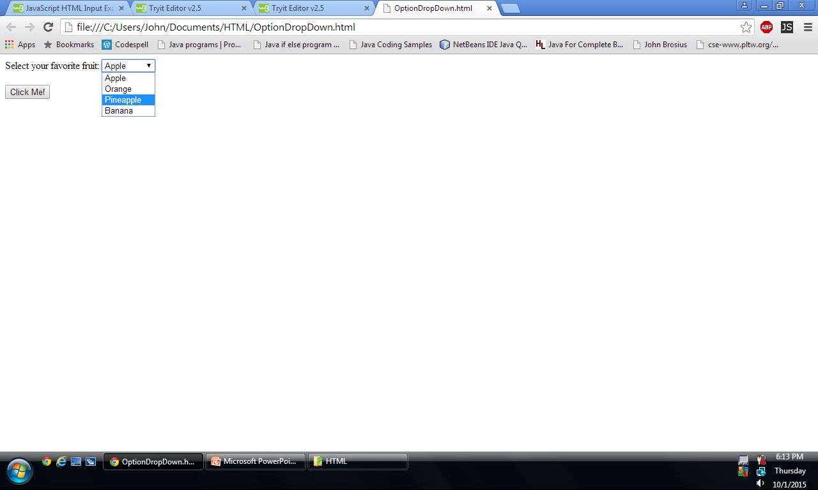
Drop Down Menu Screen

Slide 18
Insertion
Include two of the following elements into your car page that you have created.
I will be evaluating what you have done as you work and I will be looking at yesterdays assignment to see how you progressed.

Slide 19
JavaScript
Create a web page with 5 Java Script elements
Two of which can be from class.
Use W3 Schools as your resource
It goes under module 6 –Called JavaScript
Objective
Students should understand how to use JavaScript and how it works within a web page.

